Slide 1
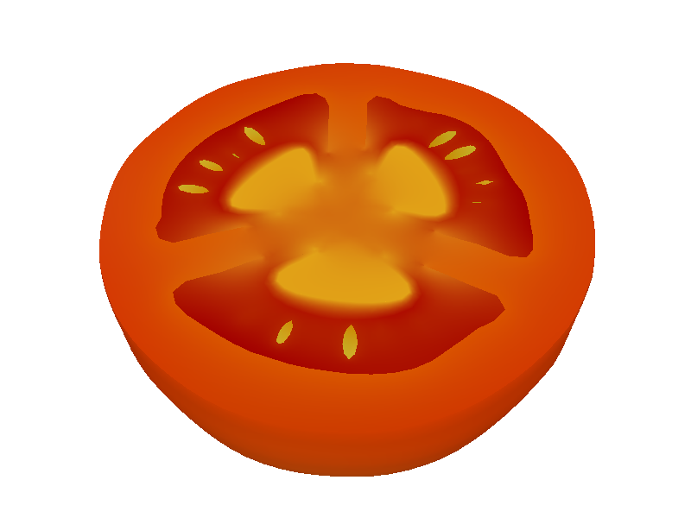
Volumetric Modeling with Diffusion Surfaces
Kenshi Takayama
The University of Tokyo
kenshi84@gmail.com
Olga Sorkine
New York University
sorkine@cs.nyu.edu
Andrew Nealen
Rutgers University
andy@nealen.net
Takeo Igarashi
The University of Tokyo
JST ERATO
takeo@acm.org
Notes:
Thanks for the introduction. Hello, I’m Kenshi Takayama.
Today I’m going to present our work on volumetric modeling with Diffusion Surfaces.
This is a joint collaboration with Olga Sorkine, Andy Nealen, and my advisor Takeo Igarashi.

Slide 2
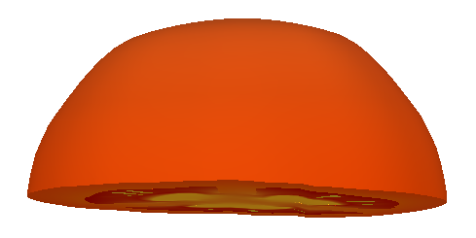
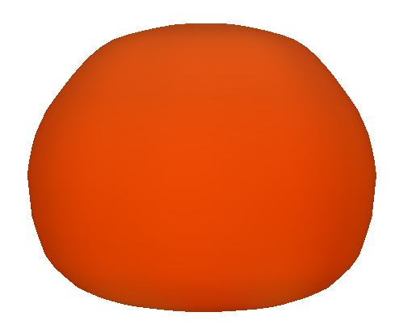
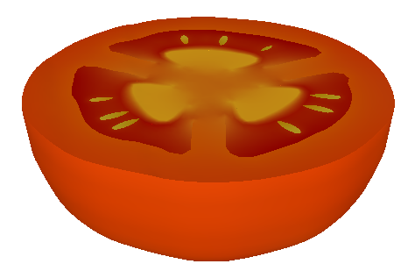
Motivation
Interactive freeform cutting of fruit & vegetables
Why fruit & vegetables?
One example problem in volumetric modeling
Common volumetric objects in our daily lives
cut!
demo
Notes:
The motivation of our work is to allow interactive and freeform cutting of 3D fruits and vegetables.
Here I’m gonna show you a quick demo.
----(demo begins)----
This is a 3D tomato model, and I can cut it by drawing a freeform stroke.
It takes about 7 or 8 seconds to compute the cross-section.
Let me show you another cross-section.
OK let’s go back to the slides.
----(demo ends)----
So why do we care about fruit?
It’s because we consider fruit modeling as just one example problem in volumetric modeling that is still hard to solve.
We also think that fruit is one of the most common volumetric objects in our daily lives, and our result can be useful for many applications.

Slide 3
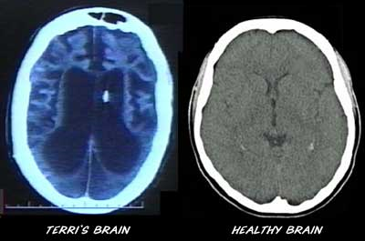
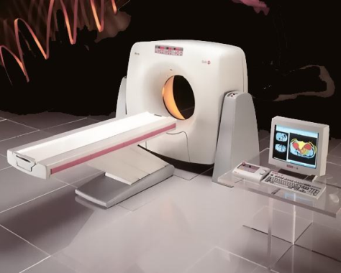
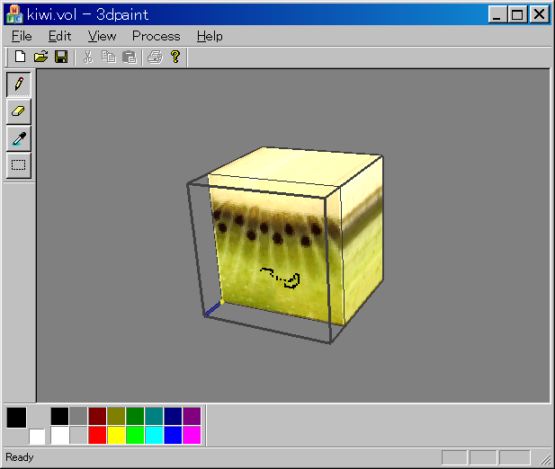
Volumetric modeling is hard
Hard to capture
Hard to create
“Painting” to voxels is painful
Large setup
No color data
Notes:
Volumetric modeling is a very hard problem in general, mainly because of the so-called curse of dimensionality.
First, 3D volumes are hard to capture. There are scanning devices such as CT and MRI, but they require large setup of course. Also they cannot be used for graphics applications directly because they cannot capture color data.
Second, 3D volumes are hard to create. We have tried a very trivial approach of “painting” to voxels by hand, which proved to be really, really painful.

Slide 4
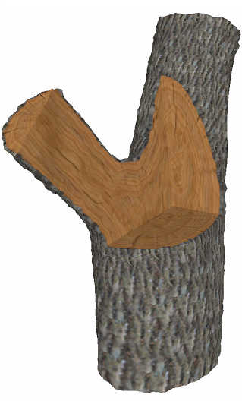
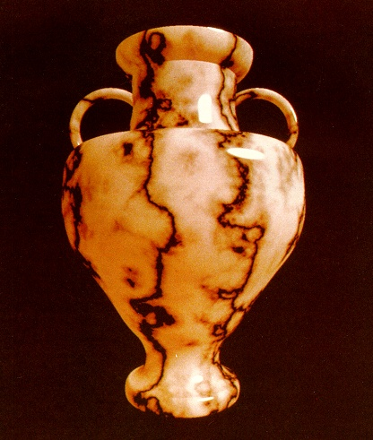
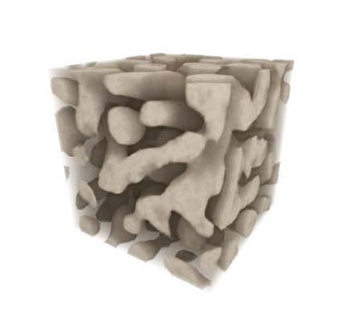
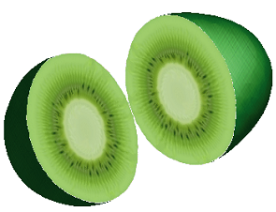
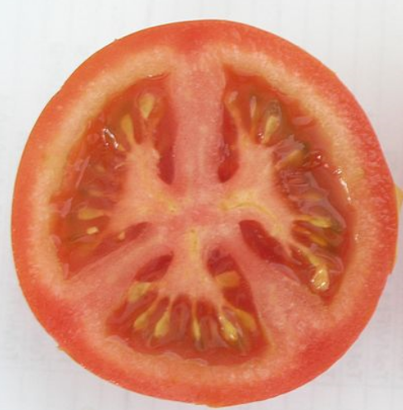
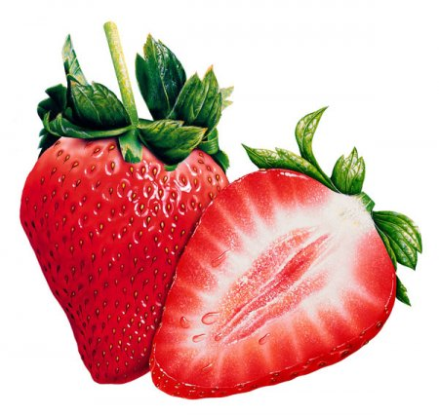
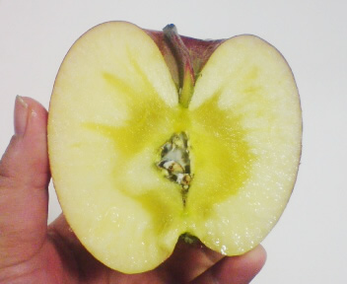
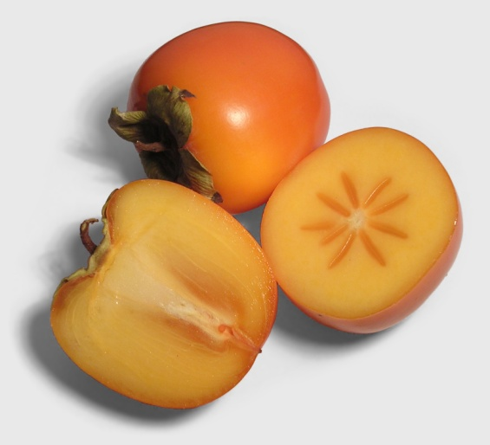
Previous approach: texture synthesis
[Perlin 1985]
[Owada 2004]
[Kopf 2007]
[Takayama 2008]
Cannot handle global structures
Not much control in the synthesis process
Notes:
Previous approaches to volumetric modeling have been mostly based on texture synthesis, including procedural texture functions by Perlin in 1985, 2D texture synthesis on 3D cross-sections by Owada et al. in 2004, solid texture synthesis from 2D exemplars by Kopf et al. in 2007, and patch-based solid texture synthesis by Takayama et al. in 2008.
These are great works! However, they cannot candle global structures which are very often found in various fruits and vegetables such as tomatoes, strawberries, apples, and persimmons. Here, I emphasize such global structures with black lines.
Also note that these methods don’t have much control over global structures in the synthesis process; They feed some data such as function parameters, texture exemplars, and control maps as input, and they have to wait until the system completes the synthesis to see what comes out of it. In other words, they only have indirect control over global structures.

Slide 5
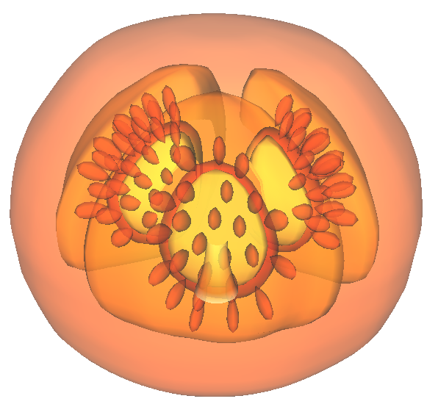
Our goal: Direct control over global structures
New representation: Diffusion Surfaces
Inspired by Diffusion Curves
Sketch-based 3D modeling interface
3D surfaces with colors
color diffused in 3D space
Notes:
So, our goal is to provide direct control over such global structures.
To enable this, we propose a new representation called Diffusion Surfaces.
Here I show a translucent visualization of the 3D tomato model which I showed earlier in the demo.
In our representation, colors are defined on 3D surfaces, and such colors are diffused in 3D space to define a volumetric color distribution.
This is strongly inspired by Diffusion Curves which I will explain shortly.
Also in this work, we propose a simple sketch-based 3D modeling interface that allows the user to create 3D fruit models with intricate structures like this tomato more easily. I will explain this in the last half of my talk.

Slide 6
Definition of Diffusion Surfaces
Notes:
OK, first I introduce the definition of Diffusion Surfaces.

Slide 7
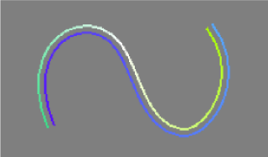
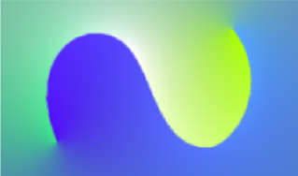
Diffusion Curves [Orzan 2008]
2D curves with colors on either side
Diffuse colors over 2D raster image
Solve 2D Poisson equation
diffuse
Notes:
Because it’s strongly inspired by Diffusion Curves proposed by Orzan et al. in 2008, let me first explain their work briefly.
Diffusion Curves are simply 2D curves with colors assigned on either side.
And such colors are diffused over 2D raster image to produce a smooth color distribution.
For this diffusion, the system solves a 2D Poisson equation.

Slide 8
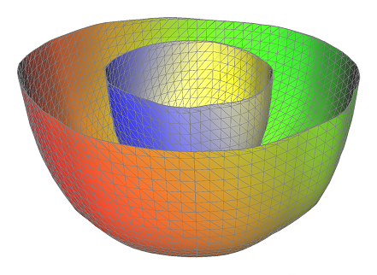
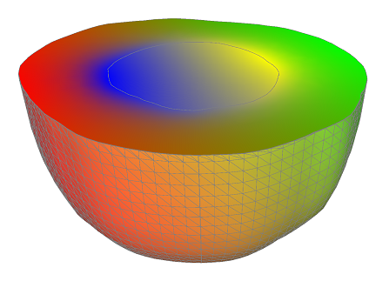
Diffusion Surfaces
3D surfaces with colors on either side
Diffuse colors over 3D volume
Solve 3D Poisson equation…?
diffuse
Notes:
Analogous to Diffusion Curves, Diffusion Surfaces are simply 3D surfaces with colors assigned to either side.
Such colors are diffused smoothly over 3D volume to produce a volumetric color distribution.
To compute this diffusion, one straightforward way would be to solve a 3D Poisson equation,…

Slide 9
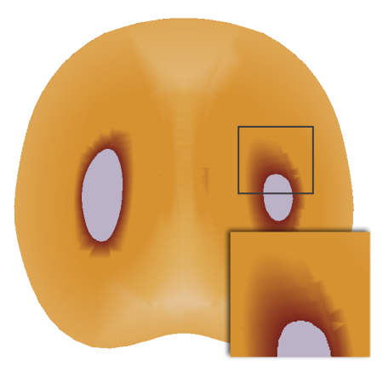
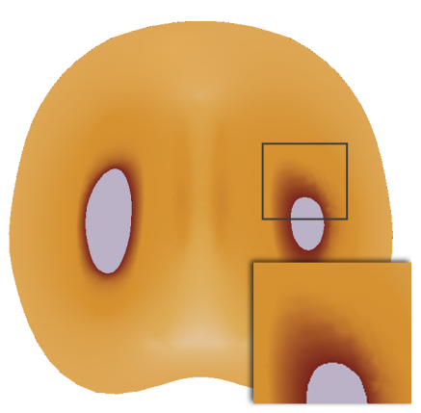
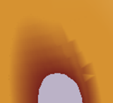
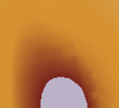
3D Poisson eq. is expensive to solve!
Large memory & heavy precomputation
Dense volume tessellation for quality
Unsuitable for interactive creation
persimmon
coarse tetra-mesh
dense tetra-mesh
artifacts
memory: 3MB
memory: 13.8MB
precomp: 9.5s
precomp: 124s
cutting: 1.1s
cutting: 3.4s
Notes:
But we found that 3D Poisson equation is very expensive to solve.
This is because it requires large memory and heavy precomputation.
In particular, it requires dense volume tessellation for achieving satisfactory quality.
Here taking persimmon as an example, this is a case where we use a coarse tetrahedral mesh to tessellate the volume. And clearly we can see artifacts in some regions.
So we need to use a much denser tetrahedral mesh, but in this case it requires much more memory, and it takes much longer time to precompute.
Note that this happens every time the model geometry is changed.
Interactive cutting at runtime is not that slow, thanks to the heavy precomputation, though.
Anyway, we think that this heavy precomputation is unsuitable for interactive creation of fruit which involves much trial and error.

Slide 10
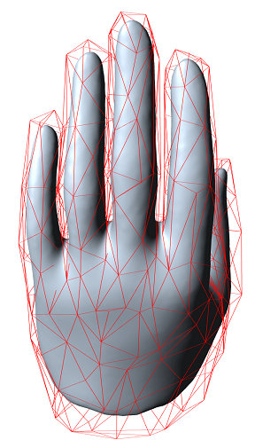
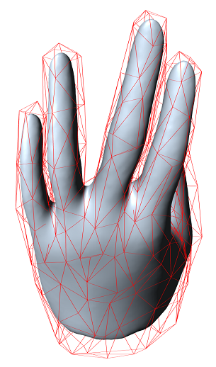
Replace Poisson eq. with PMVC
Positive Mean Value Coordinates [Lipman 2007]
Developed for cage-based mesh deformation
Diffuse properties on 3D surfaces over 3D volume
Advantage: no volume tessellation
deform
(Lipman’s) diffuse coordinates
(ours) diffuse colors
Notes:
So, our idea is to replace solving Poisson equation with a technique called PMVC.
PMVC stands for positive mean value coordinates proposed by Lipman et al. in 2007.
It was originally developed for cage-based mesh deformation.
Although their context is quite different from ours, PMVC is useful for us because it can diffuse properties defined on 3D surfaces over 3D volume.
In their case they diffuse coordinates which are essentially weights of deformation, while in our case we diffuse colors.
An important advantage of PMVC is that it doesn’t require volume tessellation, which means it is very easy to compute.

Slide 11
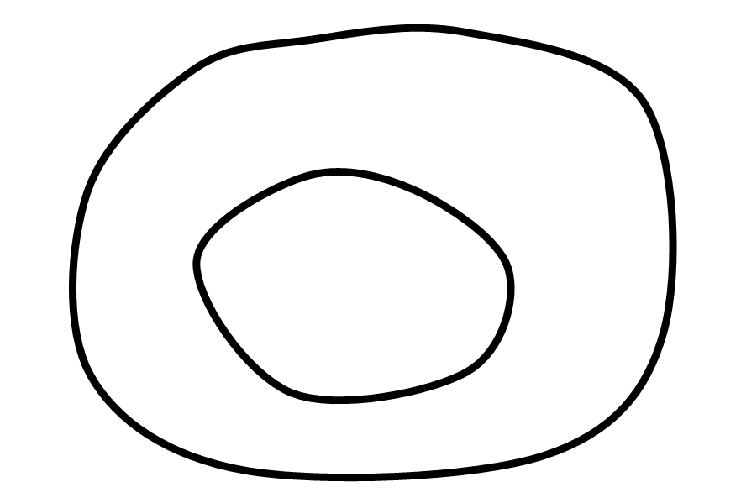
Color diffusion using PMVC (in 2D)
cut!
Notes:
Here is the actual algorithm for diffusing colors using PMVC, in 2D, just for the ease of illustration.
Given the model as a set of colored curves, and the user’s cutting stroke, we first tessellate the cross-section with vertices and edges.
Now our goal is to compute colors for all interior vertices which are shown as white circles here.

Slide 12
Color diffusion using PMVC (in 2D)
buffer in GPU
right
down
left
up
average
Notes:
To do so, for each vertex, we utilize GPU’s rendering capability.
First, we render the whole model viewed from that vertex into a buffer in the GPU.
We do this for all four directions, and take a weighted average of the colors in the buffer, and assign it to that vertex as the resulting color.

Slide 13
Color diffusion using PMVC (in 2D)
Notes:
We do this for all the interior vertices, and finally render the cross-section by simply using linear interpolation.

Slide 14
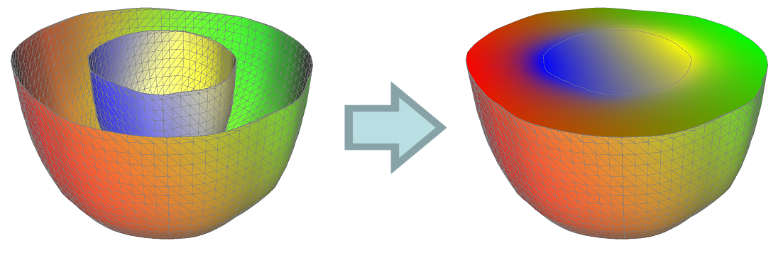
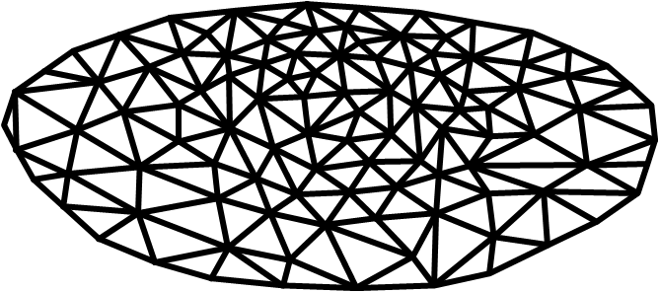
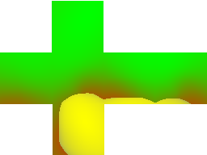
Color diffusion using PMVC (in 3D)
Same as in 2D
Always consistent color for the same 3D position
render
average
Notes:
Here I try to explain what happens in 3D. Basically the process is the same as in the 2D case.
The model consists of 3D colored surfaces, and here I show cut halves of them.
The cross-section is tessellated with triangles. For each interior vertex, we render the whole surfaces viewed from that vertex into a cube map, and take the weighted average of the cube map colors as the resulting color. We do this for all interior vertices, and finally render the cross-section using linear interpolation.
Note that this algorithm always produces consistent color at the same 3D position. Thus we have a consistent volumetric color distribution.

Slide 15
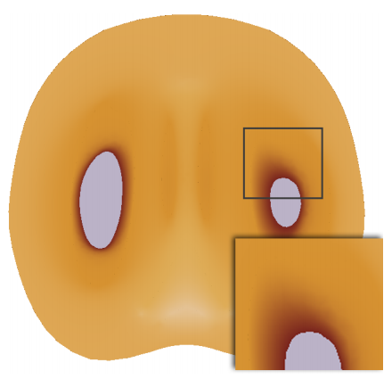
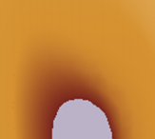
Comparison
Poisson
PMVC
comparable quality
memory:
13.8MB
630KB
precomp:
124s
–
cutting:
3.4s
4.3s
PMVC is better suited for our purpose!
Notes:
Here is a comparison of the Poisson diffusion and the PMVC diffusion.
We can see that PMVC diffusion provides comparable or even better quality,
while it requires much smaller memory,
and it does not require any precomputation, which is very suitable for interactive creation of fruit.
For the interactive cutting at runtime, it requires a little bit of time, but it’s still acceptable.
Therefore, we conclude that PMVC diffusion is better suited for our purpose than Poisson diffusion.

Slide 16
Interface for creating Diffusion Surfaces
Notes:
OK, from now on, I’d like to focus on the user interface for creating Diffusion Surfaces.

Slide 17
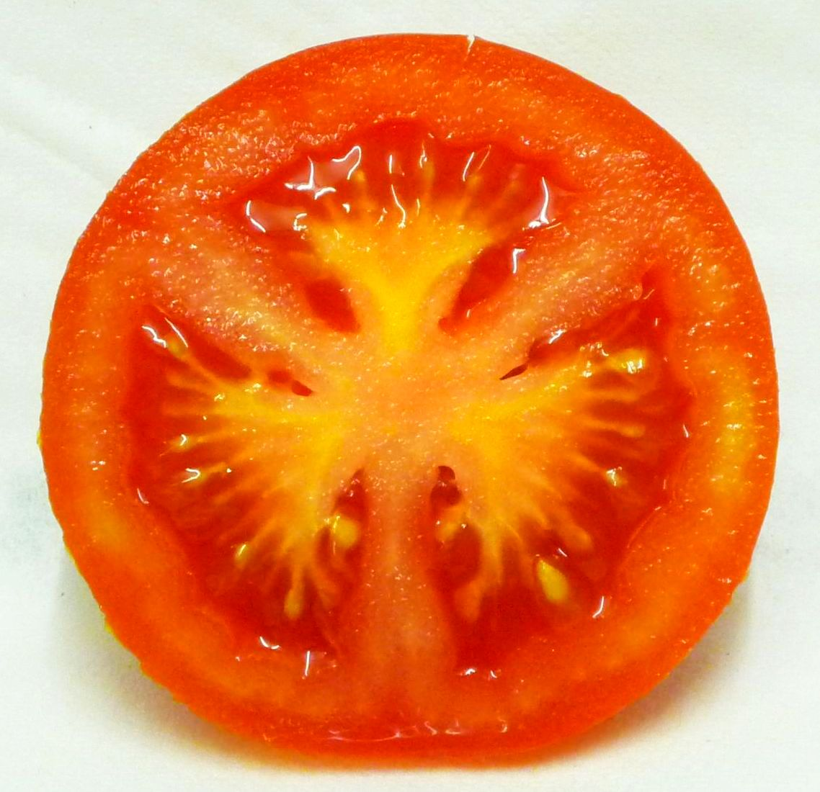
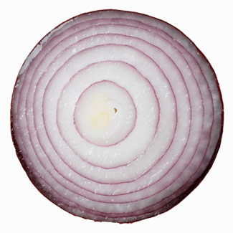
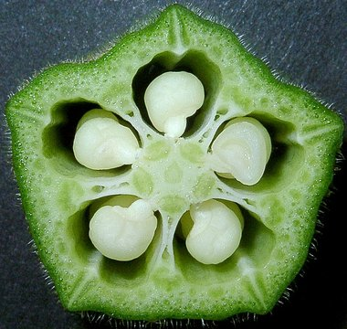
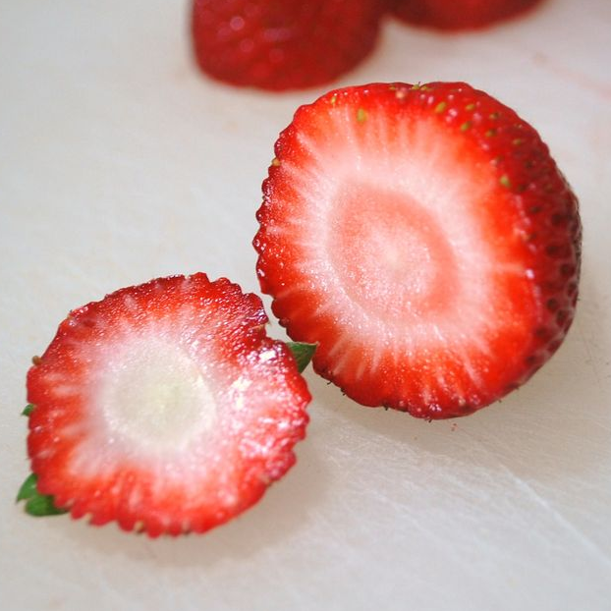
How to model fruit & vegetables?
Any 3D modeling tool could be used
3ds Max, Maya
But traditional modeling is tedious
We exploit rotational symmetry
Notes:
So, how to model fruit and vegetables?
Because the Diffusion Surfaces representation is simple and general, any existing 3D modeling tool could be used, such as 3ds Max and Maya.
But traditional modeling is tedious especially when we want to deal with intricate and repetitive structures of fruit and vegetables.
Therefore, we exploit rotational symmetry present in most fruit and vegetables to greatly simplify the modeling process.

Slide 18
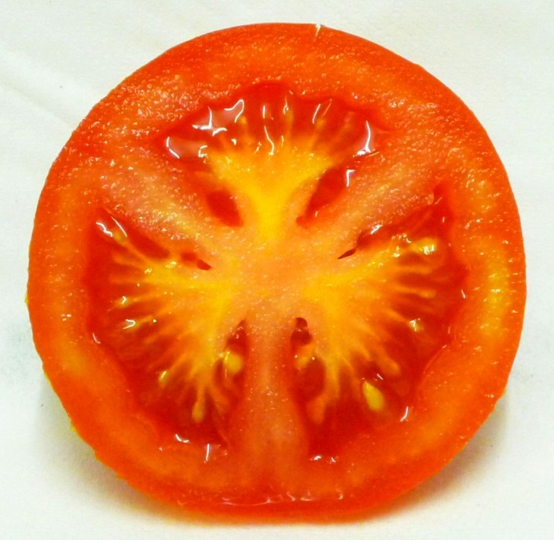
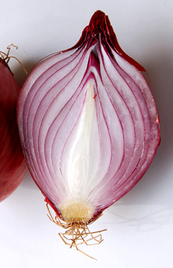
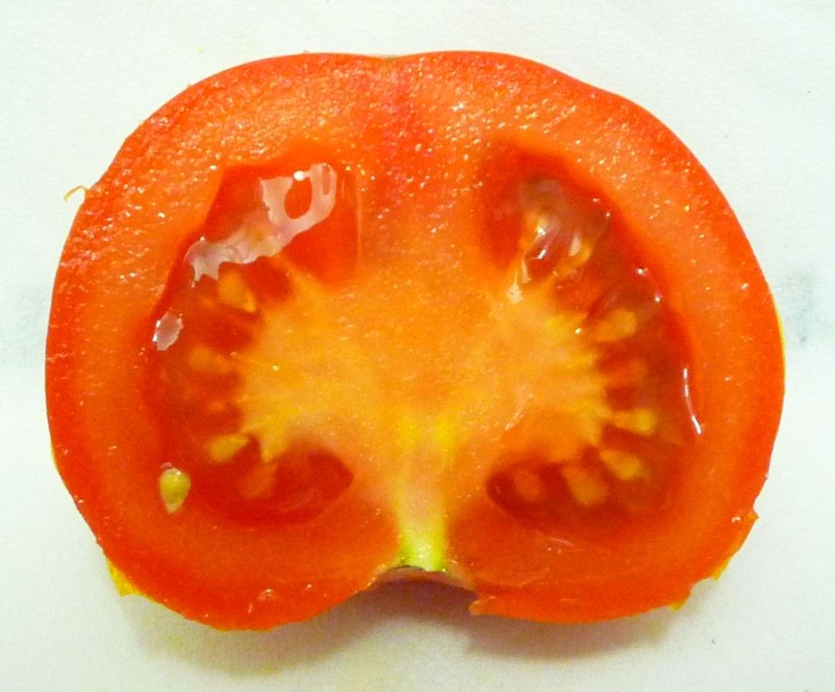
Two types of rotational symmetry
Cylindrical symmetry
N-fold symmetry
We design UIs accordingly
Notes:
In particular, we consider two types of rotational symmetry. One is cylindrical symmetry which is typically seen in objects like onions, for example. And the other is N-fold symmetry which is typically seen in objects like tomatoes for example. Here, this tomato has 3-fold symmetry.
We exploit this classification of rotational symmetry and design the user interfaces accordingly. I’m not going to talk about the details of our user interfaces, please refer to the paper for them, but the basic idea is like this.

Slide 19
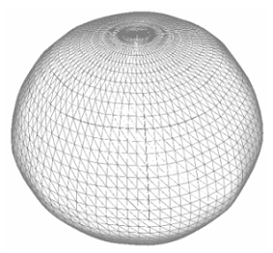
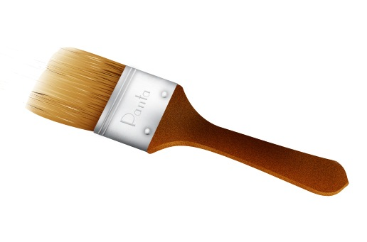
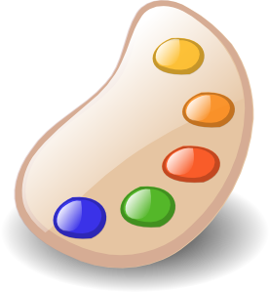
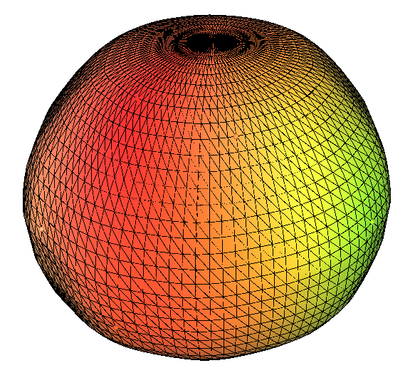

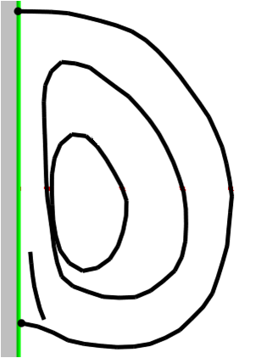
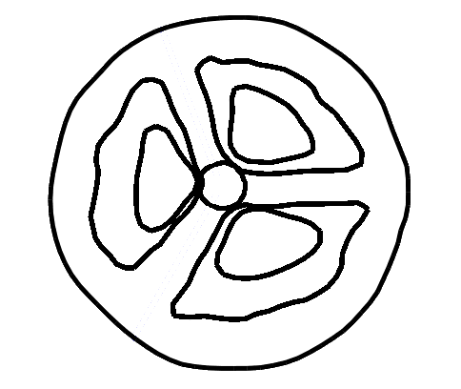
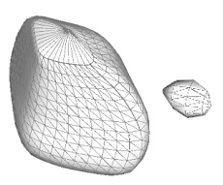
3D modeling workflow
Sketch profiles in 2D to create 3D shapes
Paint colors in 3D
surfaces generated
by sweeping
demo
Notes:
The user first sketches several profile curves in 2D to create 3D shapes.
The user can use images as a guide, and draws several profile curves from different views.
Given these pairs of curves, the system generates 3D surfaces by sweeping.
After 3D shapes are created, the user paints colors in 3D.
Here I’m going to show you a demo.
----(demo begins)----
First I load an image as a guide, and trace some profile curves. I can use several curve editing tools such as deformation and smoothing. Let’s say I completed the sketching like this.
Next I load another image from a different view. Then I move the image to a canonical location, and adjust the angles of the symmetry fold. Now I can start sketching. This curve corresponds to this curve drawn in the previous step. For this curve, I have to draw a set of 3 closed loops because this tomato has 3-fold rotational symmetry. Let’s say I completed the sketching like this.
Then the system generates 3D surfaces by sweeping. I can optionally delete some part of the surfaces.
Next I specify parameters for distributing small grains. This is important because many fruit and vegetables often have numerous small structures distributed randomly over some base surface regions, like this tomato seed.
The next step is painting colors in 3D. I use the guide image and pick up colors from it, and simply paint them over the surfaces.
Note that I can paint different colors for different sides. For this surface, the outer side is brighter than the inner side. For this surface, the outer side is much darker than the inner side.
Let’s say I completed painting colors like this.
Now the modeling is done. As an additional benefit of assuming rotational symmetry, the system can instantly generate random variations of models once the user completes modeling. I can also change the number of symmetry folds. Please refer to the paper for the actual algorithm of how we generate random variations.
OK, now we are ready to cut and see the cross-section.
Let me show you another cross-section.
We admit that this does not look super-realistic unfortunately, so we rather opt for non-photorealistic rendering approach. Here we simply apply procedural noise and artistic silhouettes to add more expressivity to the plain color rendering.
OK now let’s stop here and go back to the slides.
----(demo ends)----

Slide 20
Results
Notes:
Here I show some more results.

Slide 21
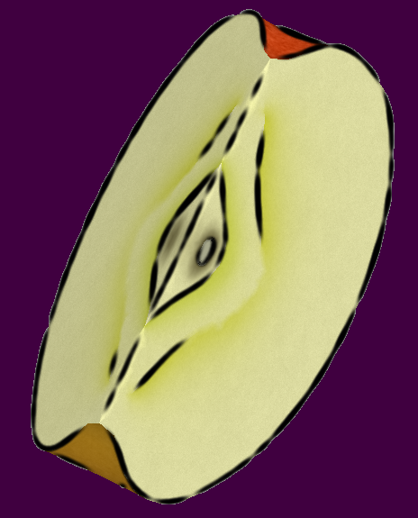
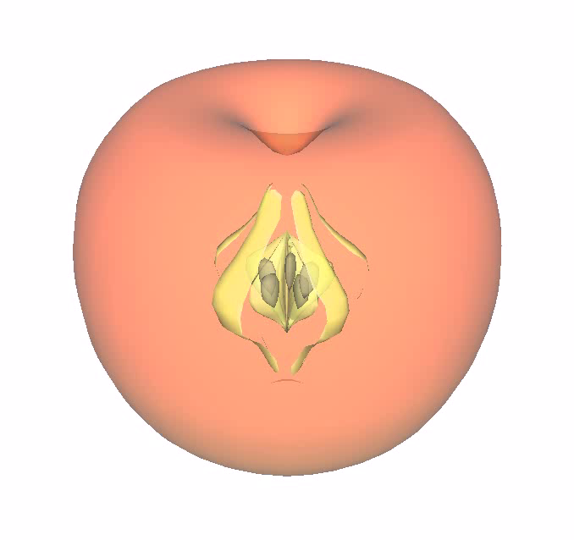
Apple

Slide 22
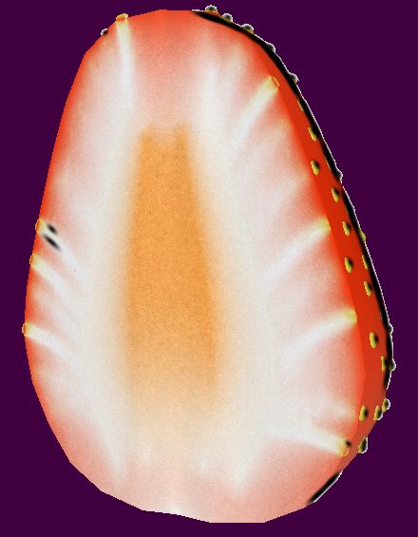
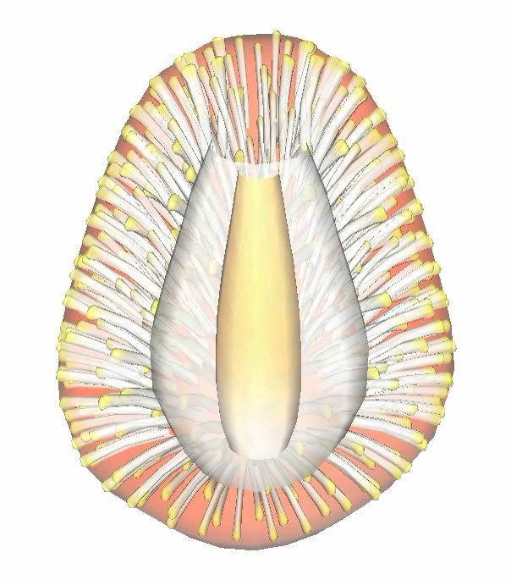
Strawberry

Slide 23


Kiwi

Slide 24


Bell pepper

Slide 25


Cucumber

Slide 26


Okra

Slide 27

Fruit bowl
Notes:
And we can easily create a scene like this fruit bowl.

Slide 28



Other than fruit & vegetables
Volcano
Kidney
Notes:
Of course we tried to model objects other than fruit, and here are two experimental results, volcano and kidney.

Slide 29


Limitations
Lack texture details
No translucency
Notes:
One big limitation of our approach is the lack of texture details.
Also, currently we are not considering translucency at all.
Solving these issues is very important for achieving truly realistic appearances.

Slide 30


Future work
Modeling UI for other classes of objects
Notes:
As a future work, we plan to explore modeling user interface for other classes of objects such as human organism and various food materials.

Slide 31


Future work
Convert scanned data to Diffusion Surfaces
pumpkin
watermelon
images from insideinsides.blogspot.com
Notes:
Another interesting direction is to convert scanned volume data such as those shown below, to Diffusion Surfaces.

Slide 32


Conclusion
Motivation:
Interactive freeform cutting of fruit
Contributions:
Diffusion Surfaces representation
Sketch-based interface for modeling fruit
Notes:
In conclusion, the motivation of our work is to allow interactive and freeform cutting of 3D fruit.
Our contributions are, first we propose the Diffusion Surfaces representation, and second, we develop a simple sketch-based interface for modeling fruit.

Slide 33
Acknowledgements
Wilmot Li & Doug DeCarlo
(suggestions on NPR techniques)
Murphy Stein
(video voiceover)
SIGGRAPH reviewers
Funding support:
JSPS Fellowship
Excellent Young Researchers Overseas Visit Program
NYU URCF
NSF (IIS-0905502, IIS-0916845)
JST ERATO
Notes:
I’d like to thank these people who helped us with this research, and the following funding agencies.

Slide 34






Thank you!
www-ui.is.s.u-tokyo.ac.jp/~kenshi/DiffusionSurfaces
kenshi84@gmail.com
Notes:
This concludes my talk, thank you!

